Slide 1
MOT1421: Economic Foundations Week 3: Production, Efficiency, Choice of Technique
Lecture Note W3-B:
• Production, efficiency, choice of technique:
Problem for the firm: the optimal choice of production technique
• Technological progress: definition and 3 types:
Neutral; labour-saving; capital-saving

Slide 2
MOT1421: Economic Foundations Week 3: The Optimal Choice of Technique
Production function: x = a L^{α} K^{β} (Cobb-Douglas)
x = output; L = labour input; K = capital input (= machines); a = the efficiency parameter.
The production function is a purely technical – engineering – relation between factor inputs and outputs.
It describes the transformation of factor inputs into products (outputs) in any particular time period. The production function represents the technology of a firm (or an industry) and it includes all the technically efficient methods of production.
Note that MP_{L} = dx/dL > 0 and MP_{K} = dx/dK > 0

Slide 3
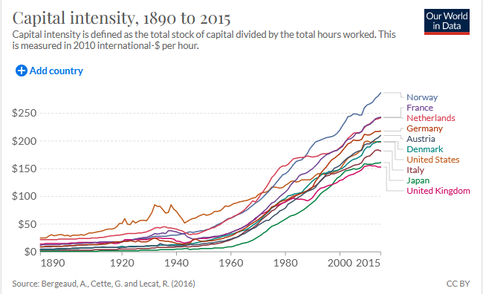
MOT1421: Economic Foundations Week 3: The Optimal Choice of Technique
The choice of technique
concerns the choice of
labour input L and capital
input K – or the choice
of K/L = capital intensity

Slide 4
MOT1421: Economic Foundations Week 3: The Optimal Choice of Technique
Production function: x = a L^{α} K^{β} (Cobb-Douglas)
The production process does exhibit:
Constant returns to scale if α + β = 1
Increasing returns to scale if α + β > 1 (manufacturing)
Decreasing returns to scale if α + β < 1 (agriculture)

Slide 5
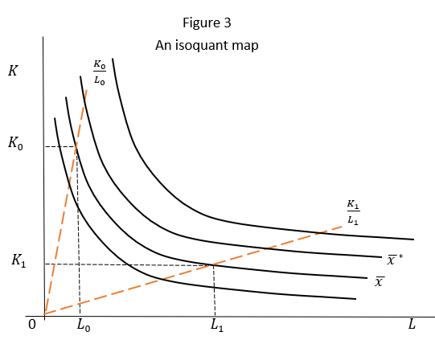
MOT1421: Economic Foundations Week 3: The Optimal Choice of Technique
Using the production
function (and fixing x)
we can derive a set of
production isoquants;
The ratio K/L is capital
intensity (= the defining
feature of production
technique).

Slide 6
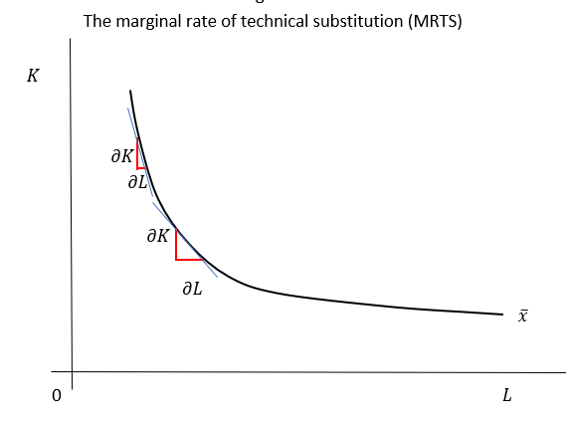
MOT1421: Economic Foundations Week 3: The Optimal Choice of Technique
Marginal Rate of
Technical Substitution
(MRTS) = dK/dL =
the slope of the
Isoquant.

Slide 7
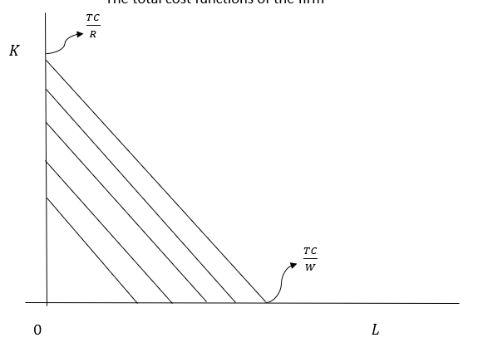
MOT1421: Economic Foundations Week 3: The Optimal Choice of Technique
The firm faces a cost restriction:
TC = W L + R K or
K = (TC/R) – (W/R) L
TC = total cost;
W = wage per hour of work;
R = price of a machine (hour).

Slide 8
MOT1421: Economic Foundations Week 3: The Optimal Choice of Technique
The question facing the (instrumentally rational) firm thus is: which technique of production (= which combination of labour and capital) is the best or optimal one?
The answer to this conundrum is: the optimal technique of production is the one that maximises firm profits.
From the optimalisation, we obtain: K*/L* = (β/α) (W/R)
where W = the wage per hour; R = the price of a machine (hour)

Slide 9
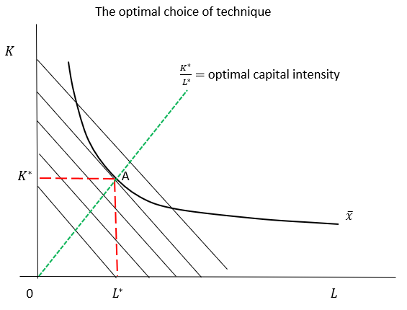
MOT1421: Economic Foundations Week 3: The Optimal Choice of Technique
The optimal choice
of technique K*/L*

Slide 10
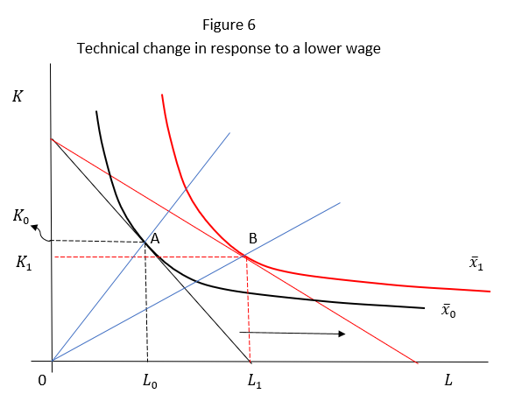
MOT1421: Economic Foundations Week 3: The Optimal Choice of Technique
Technical change
in response to
a lower wage:
optimal capital
intensity declines
from K₀/L₀ to K₁/L₁
(= capital-labour
substitution)

Slide 11
MOT1421: Economic Foundations Week 3: Technological Progress
By definition, we have:
Output = (output/hour of work) x (hours worked)
= labour productivity x hours worked
( = “working smarter” x “working more hours” )
Output growth is due to (a) productivity growth; (b) growth of hours worked.
Productivity growth = f ( technological progress)

Slide 12
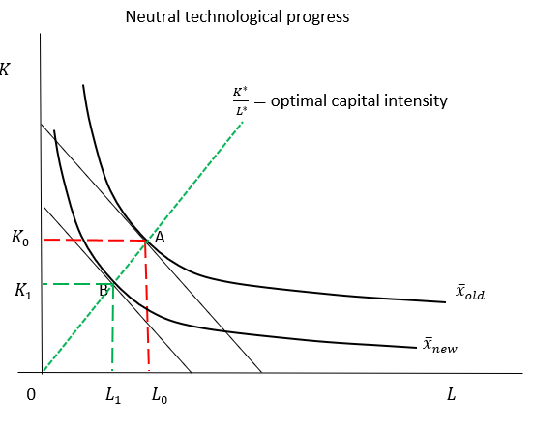
MOT1421: Economic Foundations Week 3: Neutral Technological Progress
Assume: x = a L^{α} K^{β} (α + β = 1 ; constant returns to scale)
An increase in “a”
-> neutral technological
progress

Slide 13
MOT1421: Economic Foundations Week 3: Labour-Saving Technological Progress
According to Industry Week, in the 1980s, General Motors averaged about 40 labour hours per vehicle at a Massachusetts manufacturing plant.
According to Strategic Work Systems Inc., an auto manufacturing consultant, Nissan Motors was the most productive vehicle manufacturer in North America as of 2010, averaging 28.46 labor hours per vehicle. This was followed by Toyota (29.4 hours per vehicle), Honda Motor Co. (32.51 hours per vehicle), and Chrysler Group (33.71 hours per vehicle).
Labour-saving technological progress in auto manufacturing in the U.S. during 1980-2010 reduced the number of labour hours per vehicle by circa 20-25%.

Slide 14
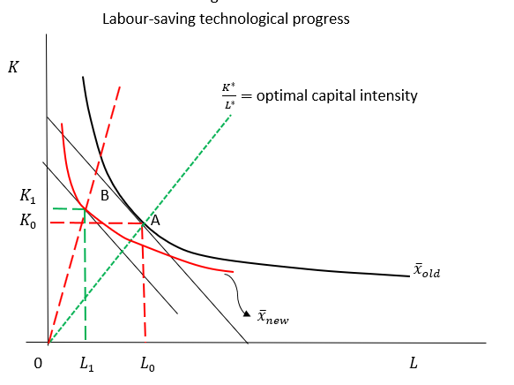
MOT1421: Economic Foundations Week 3: Labour-Saving Technological Progress
A rise in the ratio
β/ α -> labour-
saving technological
progress

Slide 15
MOT1421: Economic Foundations Week 3: Capital-Saving Technological Progress
Check this in Lecture Note W3-B - pp. 18-19.

